Slide 1

Part 2: Data Sources
(WHO & WHAT)

Slide 2







Three Critical Questions (Revans)
Who Cares?
People affected by the problem: those with emotional investment, stake in the outcome
Who Knows?
People with knowledge about the problem: technical experts, front-line staff, those with experience
Who Can Act?
People with power to implement solutions: decision-makers, budget holders, senior leaders
These three groups often don't overlap. You need to curate the balance.

Slide 3
Engaging the Whole Client System
Weisbord’s (1987) Discovery Approach (watch his YouTube talk)
Consultancy is no longer about technical expertise - but about orchestrating change.
01
02
03
Complete Stakeholder Mapping
Cross-System Representatives
Continuity Across Phases
Identify everyone affected across the system
Include diverse voices from all levels
Same people in discovery, recommendations, implementation
People are more committed to solutions they helped discover.
"Engage members of the community you want to change in the process of discovery, making them the 'evangelists of their own conversion experience.'" —Pascale & Sternin (2005)

Slide 4


Who can we collect data from?
Access to key people and sources is critical.
How open is the client to letting you into the "bowels" of the organisation?
Your contracting conversation should have specified access to people and records, client involvement, resources ....
Still: political dynamics can steer you towards some informants and away from others …. what you're allowed to see may be carefully curated.

Slide 5
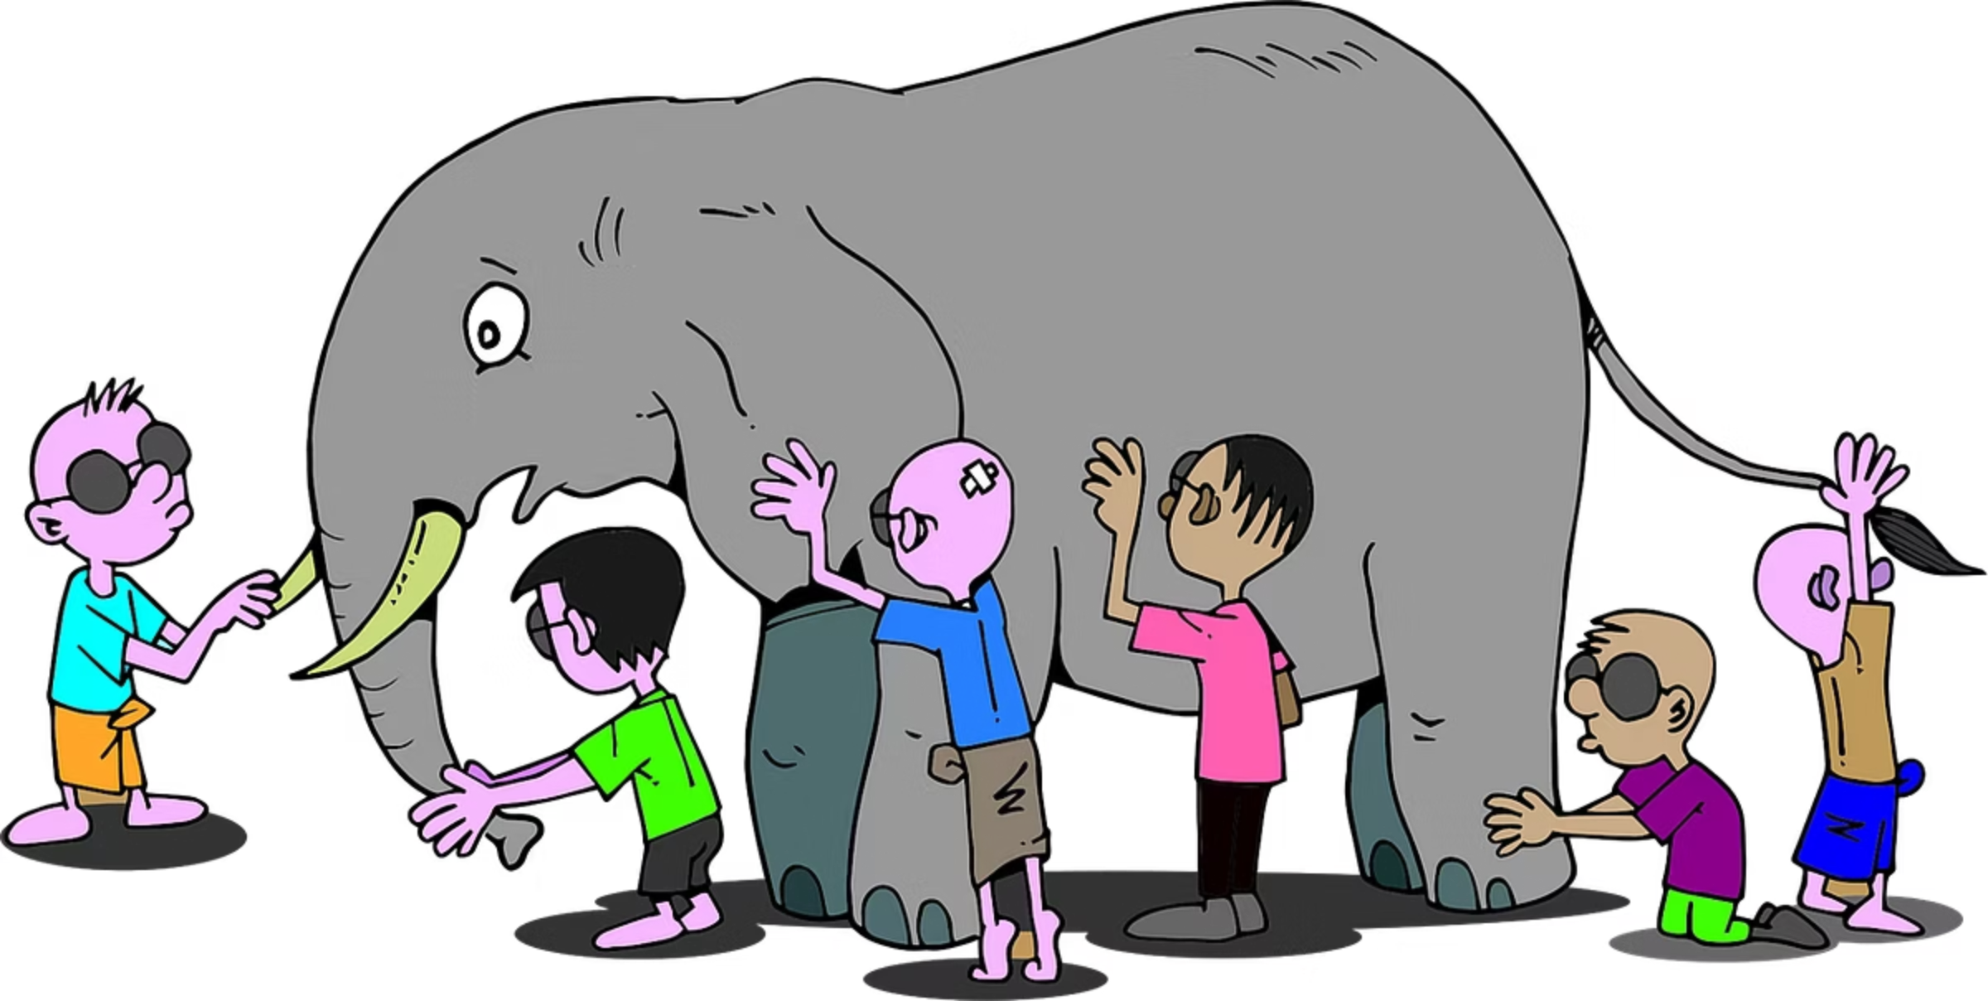
Four things to understand
Nature of Problem
Client's Role
What's actually happening?
How are they causing or maintaining it?
Shared (explicit) Understanding
Others' Role
How are others contributing to the problem? How are they benefiting from status quo
Is there a difference between the presenting problem and underlying problem?
This requires multiple types of data -
numbers, stories, observations.

Slide 6


Schein's Framework: Knowing Where to Look
Examine organisational situations across two dimensions
Task Issues
Interpersonal Issues
Content
Formal agenda, stated goals
Who is doing/saying what, to whom
Process
How the task is actually done
How members relate, communicate
Structure
Recurrent processes, SOPs
Recurrent relationships, roles
Consultants often get "seduced by content" (the what) and focus too little on the how and the structure that shapes this.
Resistance depends on the focus of interventions. Interpersonal interventions are threatening - but can be critical.

Slide 7


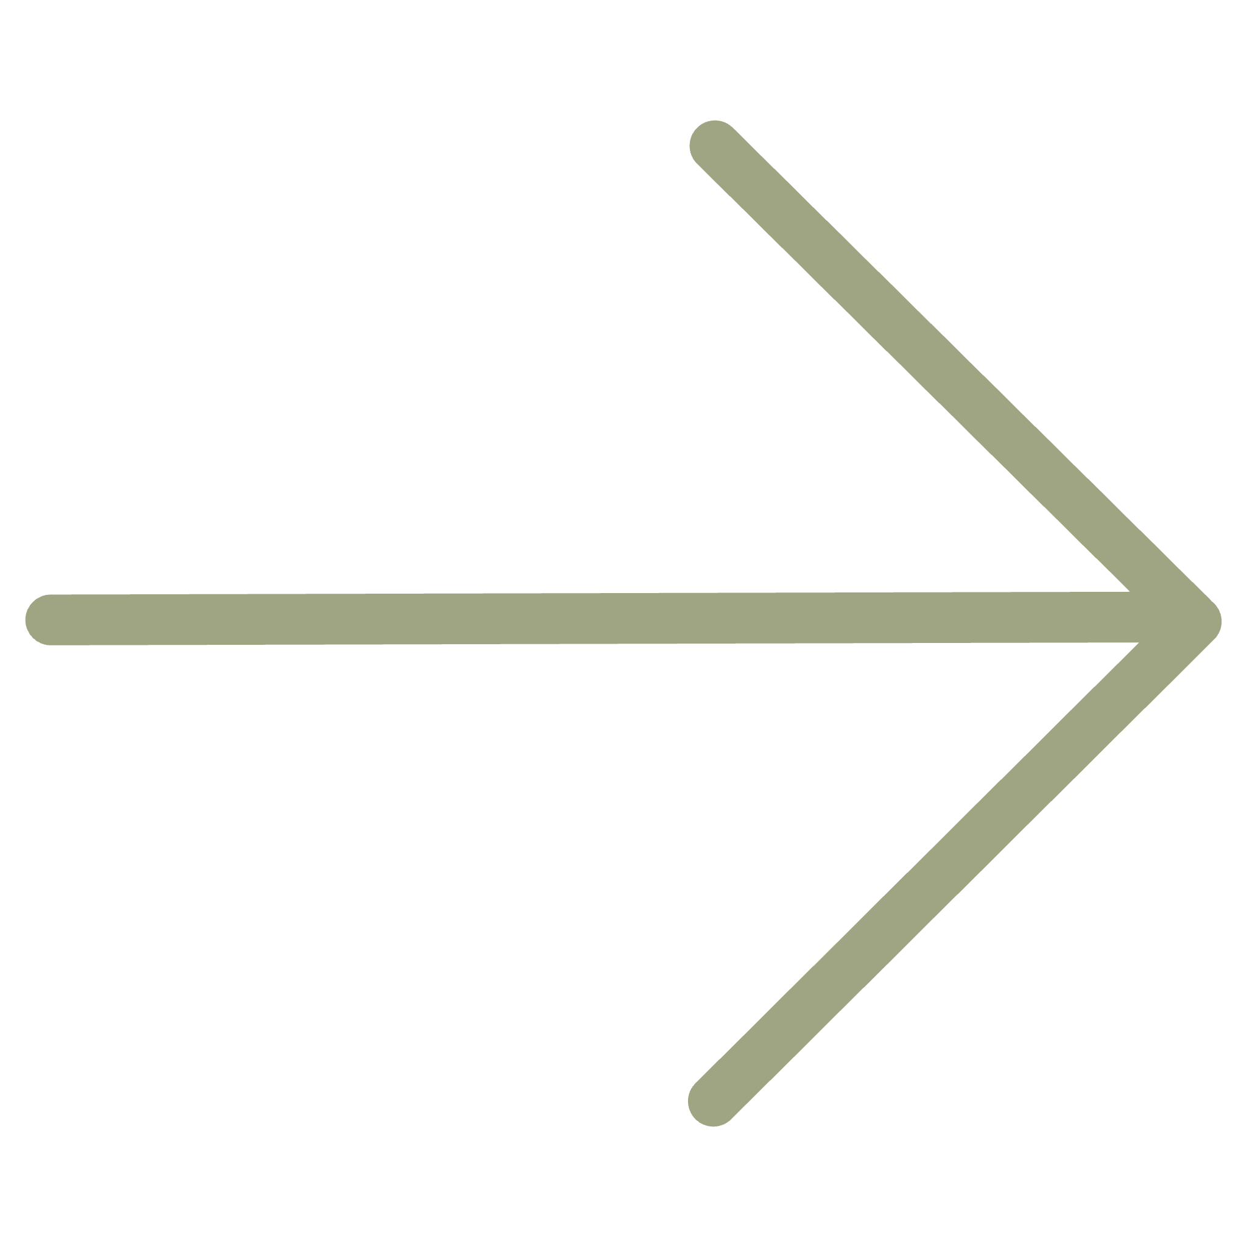
Your reflection
Think about an issue that matters to you in your own organisation - who are the key people that know about, care about it and can act on it? How much overlap is there?
COMING UP NEXT
Practical strategies for data collection
Notes:
It's not always "client has problem, calls consultant." Sometimes consultants create the problem. We'll look at farming versus hunting, and a framework called the Pyramid of Trust.

